Slide 1
Software Engineering
Lecture 01

Slide 2
Topic Covered
Evolving Role of Software
Hardware vs. Software
Intro. to Software Engineering
Software characteristics
Software Components
Software Applications
Evolution of Software
Software Myths
Software Development Life Cycle (SDLC)
SDLC Phases

Slide 3
Evolving Role of Software
Software is a product
Transforms information - produces, manages, acquires, modifies, displays, or transmits information
Delivers computing potential of hardware and networks
Software is a vehicle for delivering a product
Controls other programs (operating system)
Effects communications (networking software)
Helps build other software (software tools & environments)

Slide 4
What is Software ?
Software can define as:
Instruction – executed provide desire features, function & performance.
Data structure – to adequately manipulate operation.
Documents – operation and use of the program.
Software products may be developed for a particular customer or may be developed for a general market.
Software products may be
Generic - developed to be sold to a range of different customers e.g. PC software such as Excel or Word.
Bespoke (custom) - developed for a single customer according to their specification.

Slide 5
Hardware vs. Software
Hardware | Software
Manufactured wear out Built using components Relatively simple | Developed/ engineered deteriorate Custom built Complex

Slide 6
Manufacturing vs. Development
Once a hardware product has been manufactured, it is difficult or impossible to modify. In contrast, software products are routinely modified and upgraded.
In hardware, hiring more people allows you to accomplish more work, but the same does not necessarily hold true in software engineering.
Unlike hardware, software costs are concentrated in design rather than production.

Slide 7
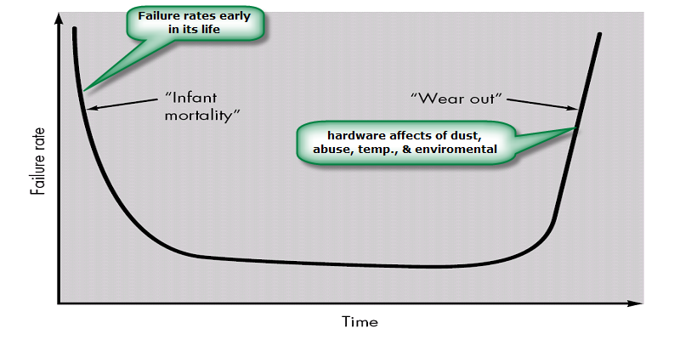
Failure curve for Hardware

Slide 8
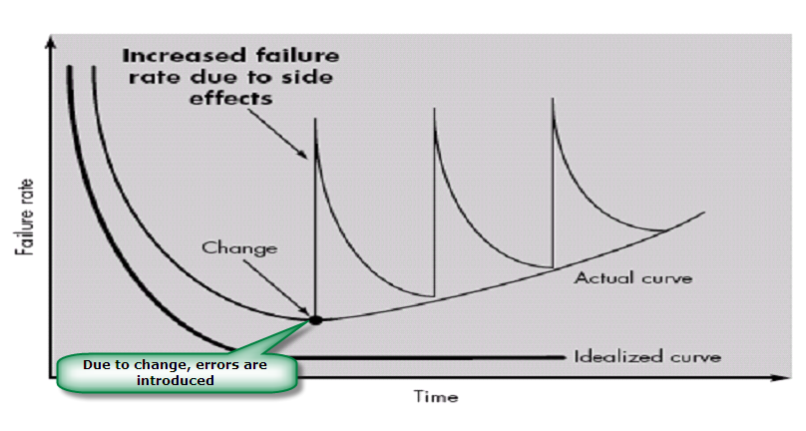
Failure curve for Software
When a hardware component wears out, it is replaced by a spare part.
There are no software spare parts. Every software failure indicates an error in design or in the process through which design was translated into machine executable code. Therefore, software maintenance involves considerably more complexity

Slide 9
Component Based vs. Custom Built
Hardware products typically employ many standardized design components.
Most software continues to be custom built.
The software industry does seem to be moving (slowly) toward component-based construction.

Slide 10
What is Software Engineering?
The process of solving customers’ problems by the systematic development and evolution of large, high-quality software systems within cost, time and other constraints
Note:
Process, systematic (not ad hoc), evolutionary…
Constraints: high quality, cost, time, meets user requirements

Slide 11
Analysis of the Definition:
Systematic development and evolution
An engineering process involves applying well understood techniques in a organized and disciplined way
Many well-accepted practices have been formally standardized
e.g. by the IEEE or ISO
Most development work is evolutionary

Slide 12
Analysis of the Definition:
Large, high quality software systems
Software engineering techniques are needed because large systems cannot be completely understood by one person
Teamwork and co-ordination are required
Key challenge: Dividing up the work and ensuring that the parts of the system work properly together
The end-product that is produced must be of sufficient quality

Slide 13
Analysis of the Definition:
Cost, time and other constraints
Finite resources
The benefit must outweigh the cost
Others are competing to do the job cheaper and faster
Inaccurate estimates of cost and time have caused many project failures

Slide 14
Software characteristics
Software is developed or engineered; it is not manufactured.
Software does not “wear out” but it does deteriorate.
Software continues to be custom built, as industry is moving toward component based construction.

Slide 15
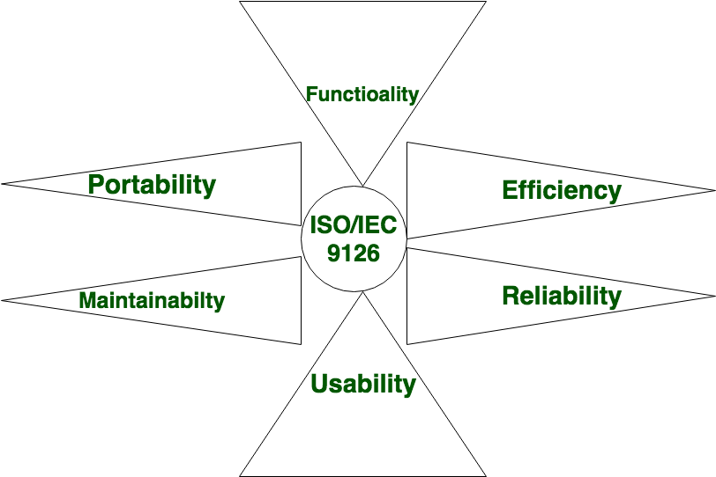
Software Components
Source: https://www.geeksforgeeks.org/software-engineering-software-characteristics/

Slide 16
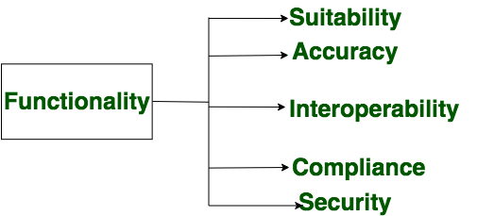
Functionality
It refers to the degree of performance of the software against its intended purpose.

Slide 17
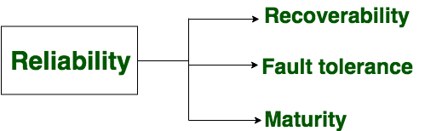
Reliability
A set of attributes that bears on the capability of software to maintain its level of performance under the given condition for a stated period of time.

Slide 18
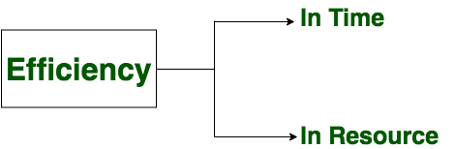
Efficiency
It refers to the ability of the software to use system resources in the most effective and efficient manner. The software should make effective use of storage space and executive command as per desired timing requirements.

Slide 19
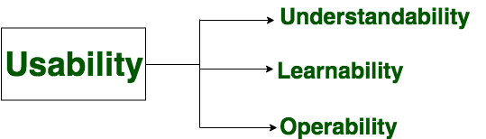
Usability
It refers to the extent to which the software can be used with ease. the amount of effort or time required to learn how to use the software.

Slide 20
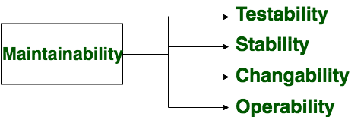
Maintainability
It refers to the ease with which the modifications can be made in a software system to extend its functionality, improve its performance, or correct errors.

Slide 21
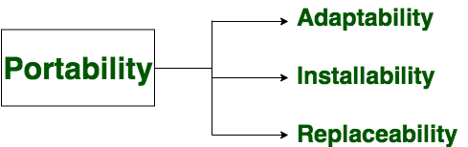
Portability
A set of attributes that bears on the ability of software to be transferred from one environment to another, without or minimum changes.

Slide 22
Software Applications
System software
Application software
Engineering/scientific software
Embedded software
Product line software
Web applications
Artificial intelligence software

Slide 23
System Software:
System software is a collection of programs written to service other programs.
It is characterized by heavy interaction with computer hardware; heavy usage by multiple users; concurrent operation that requires scheduling, resource sharing, and sophisticated process management; complex data structures; and multiple external interfaces.
Ex. Compilers, operating system, drivers etc.
Application Software :
Application software consists of standalone programs that solve a specific business need.
Application software is used to control the business function in real-time.
Engineering /Scientific software:
Characterized by "number crunching" algorithms.
Applications range from astronomy to volcano logy, from automotive stress analysis to space shuttle orbital dynamics, and from molecular biology to automated manufacturing.
Ex. Computer Aided Design (CAD), system stimulation etc.

Slide 24
Embedded Software:
It resides in read-only memory and is used to control products and systems
Embedded software can perform limited and esoteric functions.
Ex. keypad control for a microwave oven.
Product line software:
Designed to provide a specific capability for use by many different customers, product line software can focus on a limited and esoteric marketplace.
Ex. Word processing, spreadsheet, CG, multimedia, etc.
Web Applications:
Web apps can be little more than a set of linked hypertext files.
It evolving into sophisticated computing environments that not only provide standalone features, functions but also integrated with corporate database and business applications.
Artificial Intelligence software
AI software makes use of non-numerical algorithms to solve complex problems that are not amenable to computation or straightforward analysis
Ex. Robotics, expert system, game playing, etc.

Slide 25
Software Crisis Problem
Increasing cost of Computers
Increasing product complexity
Lack of programmers
Slow programmer’s productivity growth
Lack of funding for software engineering research
Rising demand for software
Lack of caffeine in software development organizations

Slide 26
Software Crisis Problem
Increasing cost of Computers
Increasing product complexity
Lack of programmers
Slow programmer’s productivity growth
Lack of funding for software engineering research
Rising demand for software
Lack of caffeine in software development organizations
Notes:
So now let's take a quick break and have a recap of what we just discussed. I want you to think about what are the major causes of the software crisis. I'm going to provide you a set of possibilities and I would like for you to mark all that apply.
Was that increasing costs of computers?
Was it increasing product complexity,
or maybe the lack of programmers?
Or was it, instead, this slow programmers productivity growth?
The lack of funding for software engineering research?
The rise in demand for software?
And finally, was it maybe the lack of caffeine in software development organizations?
Again, mark all that apply.

Slide 27
Development Effort
Size (LOC) | Example
10ˆ2 | Class exercise
10ˆ3 | Small Project
10ˆ4 | Term Project
10ˆ5 | Word processor
10ˆ6 | Operating System
10ˆ7 | Distributed System
}
Programming
effort
}
Software
Engineering
effort
Notes:
It is not the same thing to write software for a class exercise or a small project, or a temp project, than it is to build a software for a word processor, an operating system, a distributed system, or even more complex and larger system. And what I'm giving here is just an indicative size for the software so the class exercise might be 100 lines of code,
the small project might be 1000 lines of code, in the other thousand
lines of code, and so on and so forth. For the former,
the heroic effort of an individual developer can get the job done.
So that's what we call a programming effort. If you're a good
programmer, you can go sit down and do it, right. For the latter,
this is not possible. This is what we called the
software engineering effort. In fact, no matter how much programming languages,
development environments, and software tools improve, developers could not keep
up with increasing software size and complexity. Which leads us to
the third problem that I want to mention and the
third reason for the software crisis.

Slide 28
Developers Productivity Growth
S/W size & complexity
Developer’s productivity
Notes:
And this cause is the slow developer's productivity growth. So let me show this again with a qualitative diagram. And this is taken from the IEEE Software Magazine. And what I'm showing here is the growth in
software size and complexity over time, and how the developers' productivity really couldn't keep up with this additional software complexity, which resulted in this gap between what was needed and what was actually available.

Slide 29
Rising Demand for Software
HW => SW
Growth in NASA’s
Software Demand
1950
1998
Notes:
The first cause was the rising demand for software.
12
00:00:35,760 --> 00:00:38,500
Now you're used to see software everywhere: in your phone,
13
00:00:38,500 --> 00:00:41,530
in your car, even your washing machine. Before the 60s,
14
00:00:41,530 --> 00:00:44,590
however, the size and complexity of software was very limited
15
00:00:44,590 --> 00:00:47,580
and hardware components were really dominating the scene. Then things
16
00:00:47,580 --> 00:00:51,490
started to change and software started to be increasingly prevalent.
17
00:00:51,490 --> 00:00:53,940
So we move from a situation where everything was mostly
18
00:00:53,940 --> 00:00:57,380
hardware to a situation in which software became more and more
19
00:00:57,380 --> 00:01:00,660
important. To give an example, I'm going to show you the growth
20
00:01:00,660 --> 00:01:04,080
in the software demand at NASA along those years. And in
21
00:01:04,080 --> 00:01:07,610
particular, from the 1950s to more or less 2000. And this
22
00:01:07,610 --> 00:01:10,350
is just a qualitative plot but that's more or less the
23
00:01:10,350 --> 00:01:13,880
ways things went. So the demand for software in NASA grow
24
00:01:13,880 --> 00:01:16,930
exponentially. And the same happened in a lot of other companies.
For example, just to cite one, for Boeing.
So the amount of software on airplanes became larger and larger.
The second cause for the software crisis was the increasing amount
of development effort needed due to the increase of product complexity.
Unfortunately, software complexity does not increase linearly with size.

Slide 30
Software Evolution
The Law of Continuing Change (1974): E-type (Real world implemented) systems must be continually adapted else they become progressively less satisfactory.
The Law of Increasing Complexity (1974): As an E-type system evolves its complexity increases unless work is done to maintain or reduce it.
The Law of Self Regulation (1974): The E-type system evolution process is self-regulating with distribution of product and process measures close to normal.
The Law of Conservation of Organizational Stability (1980): The average effective global activity rate in an evolving E-type system is invariant over product lifetime.

Slide 31
Software Evolution
The Law of Conservation of Familiarity (1980): As an E-type system evolves all associated with it, developers, sales personnel, users, for example, must maintain mastery of its content and behavior to achieve satisfactory evolution.
The Law of Continuing Growth (1980): The functional content of E-type systems must be continually increased to maintain user satisfaction over their lifetime.
The Law of Declining Quality (1996): The quality of E-type systems will appear to be declining unless they are rigorously maintained and adapted to operational environment changes.
The Feedback System Law (1996): E-type evolution processes constitute multi-level, multi-loop, multi-agent feedback systems and must be treated as such to achieve significant improvement over any reasonable base.

Slide 32
Software Myths
Definition: Beliefs about software and the process used to build it. Myths have number of attributes that have made them insidious (i.e. dangerous).
Misleading Attitudes - caused serious problem for managers and technical people.
Management myths
Managers in most disciplines, are often under pressure to maintain budgets, keep schedules on time, and improve quality.
Myth1: We already have a book that's full of standards and procedures for building
software, won't that provide my people with everything they need to know?
Reality :
Are software practitioners aware of existence standards?
Does it reflect modern software engineering practice?
Is it complete? Is it streamlined to improve time to delivery while still maintaining a focus on quality?

Slide 33
Myth2: If we get behind schedule, we can add more programmers and catch up
Reality: Software development is not a mechanistic process like manufacturing. Adding people to a late software project makes it later.
People can be added but only in a planned and well-coordinated manner
Myth3: If I decide to outsource the software project to a third party, I can just relax and let that firm build it.
Reality: If an organization does not understand how to manage and control software projects internally, it will invariably struggle when it outsource software projects

Slide 34
Customer Myths
Customer may be a person from inside or outside the company that has requested software under contract.
Myth: A general statement of objectives is sufficient to begin writing programs— we can fill in the details later.
Reality: A poor up-front definition is the major cause of failed software efforts. A formal and detailed description of the information domain, function, behavior, performance, interfaces, design constraints, and validation criteria is essential. These characteristics can be determined only after thorough communication between customer and developer.
Myth: Project requirements continually change, but change can be easily accommodated because software is flexible.
Reality: Customer can review requirements and recommend modifications with relatively little impact on cost. When changes are requested during software design, the cost impact grows rapidly. Below mentioned figure for reference.

Slide 36
Practitioner's myths
Myth1: Once we write the program and get it to work, our job is done.
Reality: Someone once said that "the sooner you begin 'writing code', the longer it'll take you to get done." Industry data indicate that between 60 and 80 percent of all effort expended on software will be expended after it is delivered to the customer for the first time.
Myth2: Until I get the program "running" I have no way of assessing its quality.
Reality: One of the most effective software quality assurance mechanisms can be applied from the inception of a project—the formal technical review.
Myth3: The only deliverable work product for a successful project is the working program.

Slide 37
Reality: A working program is only one part of a software configuration that includes many elements. Documentation provides a foundation for successful engineering and, more important, guidance for software support.
Myth4 : Software engineering will make us create voluminous and unnecessary documentation and will invariably slow us down.
Reality: Software engineering is not about creating documents. It is about creating quality. Better quality leads to reduced rework. And reduced rework results in faster delivery times.

Slide 38
Software Development Life Cycle (SDLC)
The SDLC is a framework that describes the activities performed at each stage of a software development project.
SDLC process is used by the software industry to design, develop and test high quality software. It aims to produce the quality software that meets or exceeds customer expectations, reaches completion within time and budget.

Slide 39
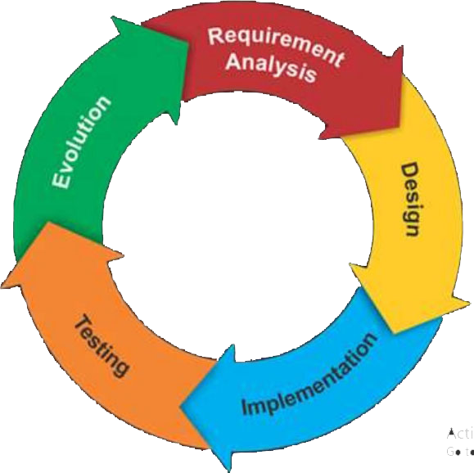
SDLC Phases

Slide 40
SDLC Phases
Planning and Requirements Analysis
Defining Requirements
Designing the Software
Building or Developing the Software
Testing the Software
Deployment and Maintenance

Slide 41
1. Planning & Requirement Analysis
Requirement analysis is the most important and fundamental stage in SDLC.
It is performed by the senior members of the team with inputs from all the stakeholders and domain experts or SMEs in the industry.
Planning for the quality assurance requirements and identification of the risks associated with the project is also done at this stage.

Slide 42
Requirements Analysis (cont.)
Business Requirements
Stakeholder Requirements
Solution Requirements
Functional Requirements
Non-functional Requirements
Transition Requirements

Slide 43
2. Defining Requirements
Once the requirement analysis is done the next step is to clearly define and document the software requirements and get them approved from the project stakeholders.
This is done through ‘SRS’ – Software Requirement Specification document which consists of all the product requirements to be designed and developed during the project life cycle.

Slide 44
Defining Requirements (cont.)
Enterprise Analysis
Business Analysis Planning & Monitoring
Elicitation
Requirements Analysis
Requirements Management & Communication
Solution Assessment & Validation
Notes:
Elicitation the process of getting or producing something, especially information or a reaction:

Slide 45
3. Designing the Software
Based on the requirements specified in SRS, usually more than one design approach for the product architecture is proposed and documented in a DDS - Design Document Specification.
This DDS is reviewed by all the stakeholders and based on various parameters as risk assessment, design modularity , budget and time constraints , the best design approach is selected for the software.

Slide 46
4. Developing the Software
In this stage of SDLC the actual development starts and the product is built. The programming code is generated as per DDS during this stage.
Developers have to follow the coding guidelines defined by their organization and programming tools like compilers, interpreters, debuggers etc are used to generate and implement the code.

Slide 47
5. Testing the Software
This stage is usually a subset of all the stages as in the modern SDLC models, the testing activities are mostly involved in all the stages of SDLC.
However this stage refers to the testing only that stage of the software where defects are reported, tracked, fixed and retested, until the software reaches the quality standards defined in the SRS.

Slide 48
6. Deployment and Maintenance
Once the software is tested and no bugs or errors are reported then it is deployed.
Then based on the feedback, the software may be released as it is or with suggested enhancements in the target segment.
After the software is deployed then its maintenance starts.

Slide 49
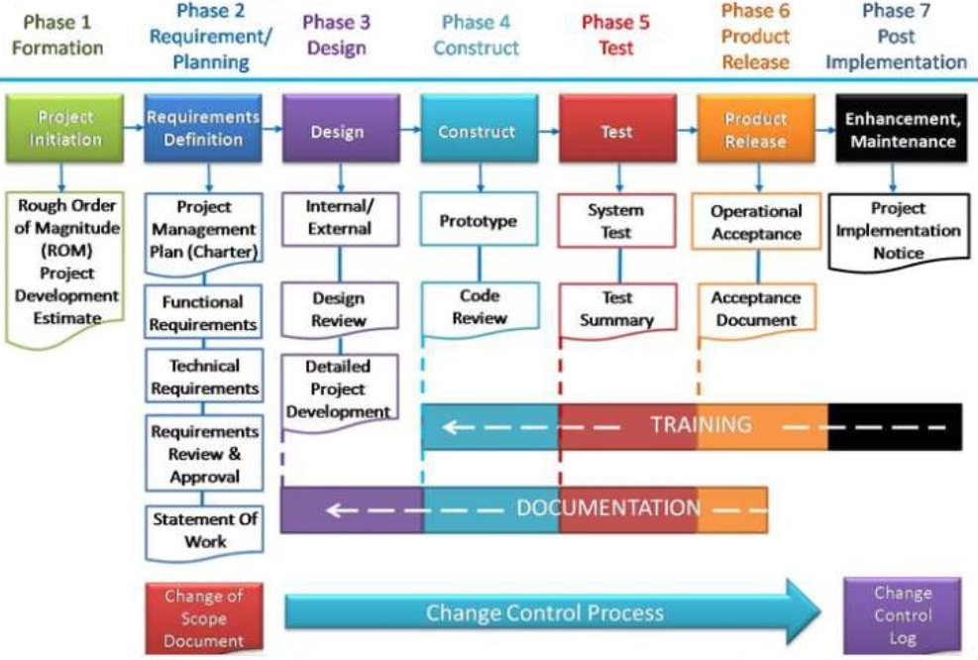

Slide 50
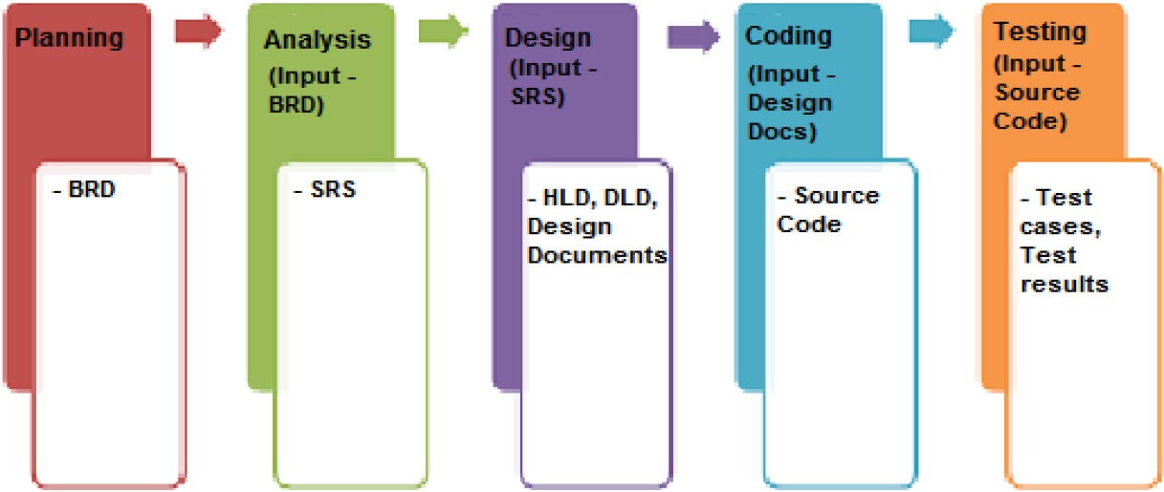
SDLC Stages & Documents
Notes:
BRD: Business Requirements Document
SRS: Software Requirement Specification
HLD: High Level Design
DLD: Digital Logic Design

